Slide 1
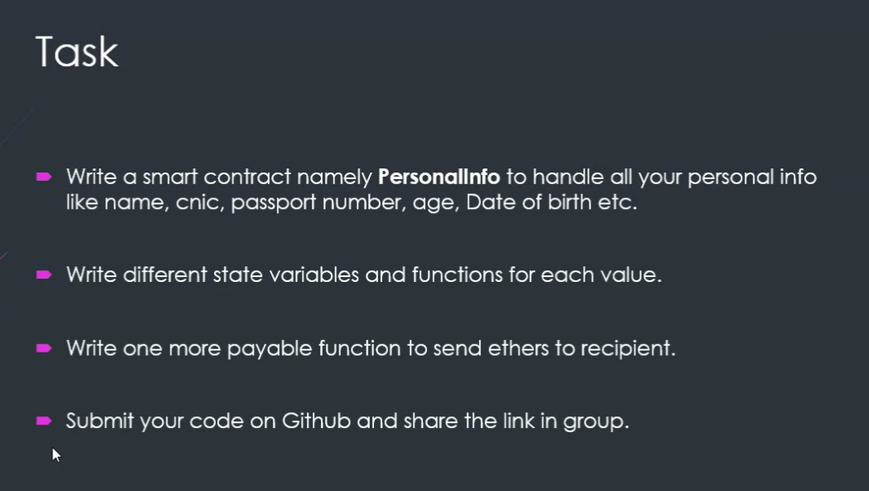
Write a smart contract namely Personal info to handle all your personal info like name, CNIC, passport number, age, Date of Birth etc.
Write different state variables and functions for each value.
Write one more payable function to send ethers to recipient
Submit your code on GitHub and share the link in the group.

Slide 2
// SPDX-License-Identifier: MIT
pragma solidity ^0.8.0;
contract PersonalInfo {
address public owner;
string public name;
string public cnic;
string public passportNumber;
uint256 public age;
uint256 public dateOfBirth;
event PersonalInfoUpdated(address indexed sender, string field, string newValue);
modifier onlyOwner() {
require(msg.sender == owner, "Not the owner");
_;
}

Slide 3
constructor() {
owner = msg.sender;
}

Slide 4
function updateName(string memory _name) public onlyOwner {
name = _name;
emit PersonalInfoUpdated(msg.sender, "name", _name);
}
function updateCNIC(string memory _cnic) public onlyOwner {
cnic = _cnic;
emit PersonalInfoUpdated(msg.sender, "cnic", _cnic);
}
function updatePassportNumber(string memory _passportNumber) public onlyOwner {
passportNumber = _passportNumber;
emit PersonalInfoUpdated(msg.sender, "passportNumber", _passportNumber);
}

Slide 5
function updateAge(uint256 _age) public onlyOwner {
age = _age;
emit PersonalInfoUpdated(msg.sender, "age", uint256ToString(_age));
}
function updateDateOfBirth(uint256 _dateOfBirth) public onlyOwner {
dateOfBirth = _dateOfBirth;
emit PersonalInfoUpdated(msg.sender, "dateOfBirth", uint256ToString(_dateOfBirth));
}
function sendEthers(address payable recipient) external payable {
require(msg.value > 0, "Amount should be greater than 0");
recipient.transfer(msg.value);
}

Slide 6
function uint256ToString(uint256 _i) internal pure returns (string memory) {
if (_i == 0) {
return "0";
}
uint256 j = _i;
uint256 length;
while (j != 0) {
length++;
j /= 10;
}
bytes memory bstr = new bytes(length);
uint256 k = length;
j = _i;
while (j != 0) {
bstr[--k] = bytes1(uint8(48 + j % 10));
j /= 10;
}
return string(bstr);
}
}

Slide 7
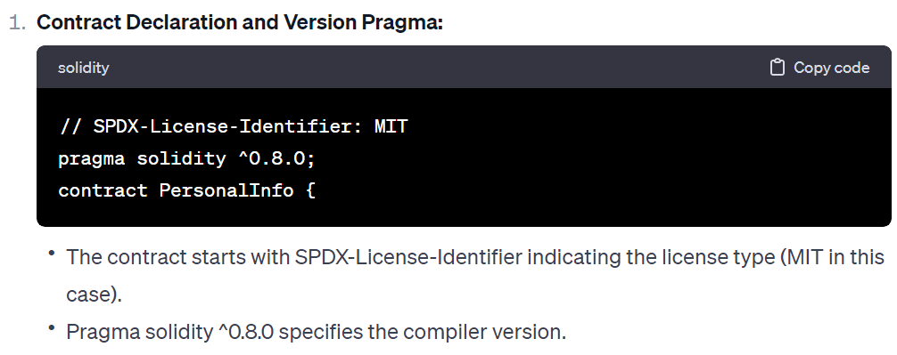
PersonalInfo" smart contract

Slide 8
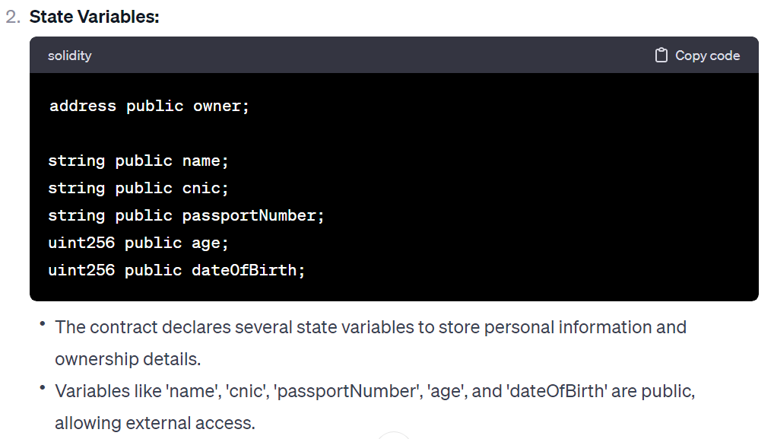

Slide 9
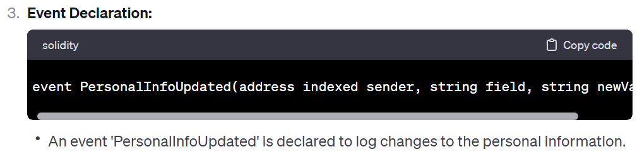
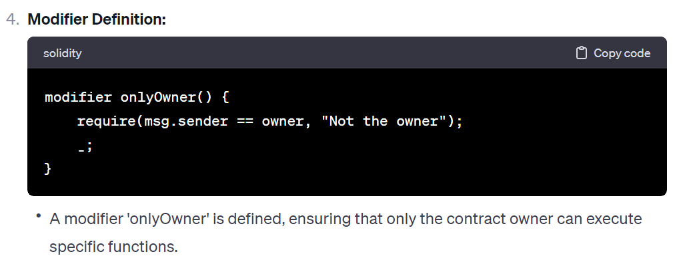

Slide 10
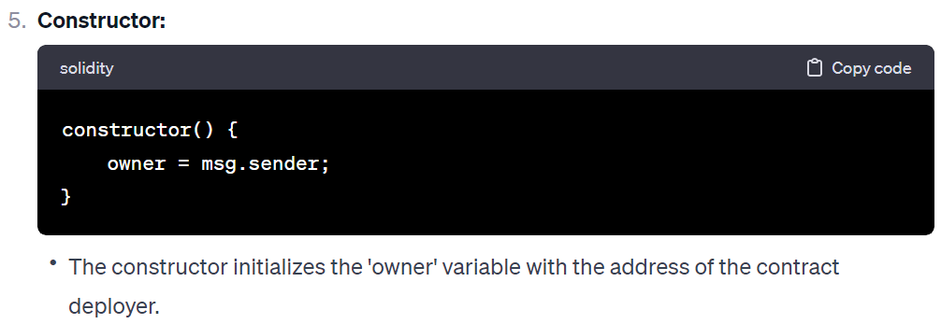

Slide 11
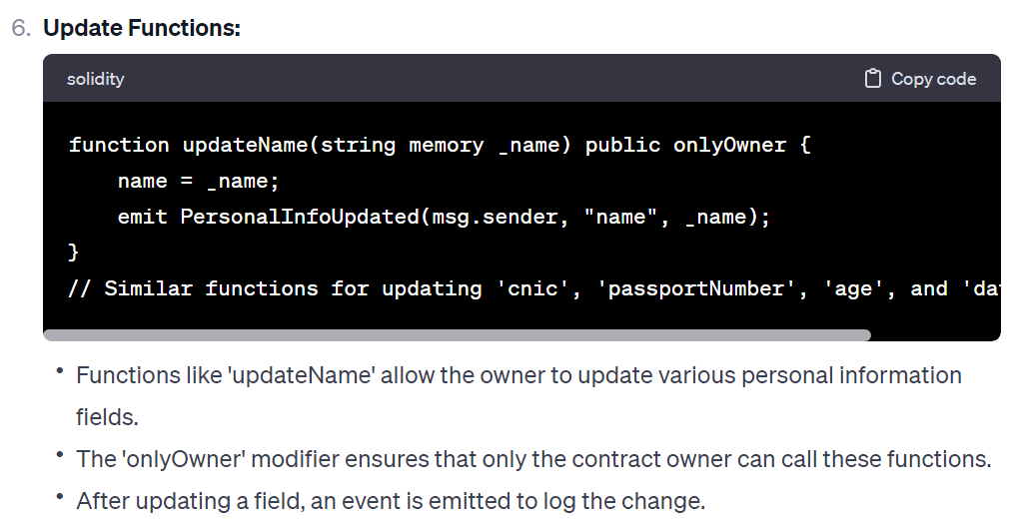

Slide 12
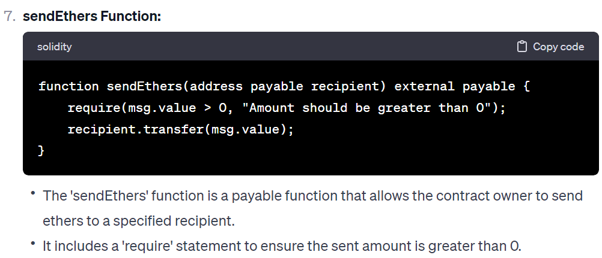

Slide 13
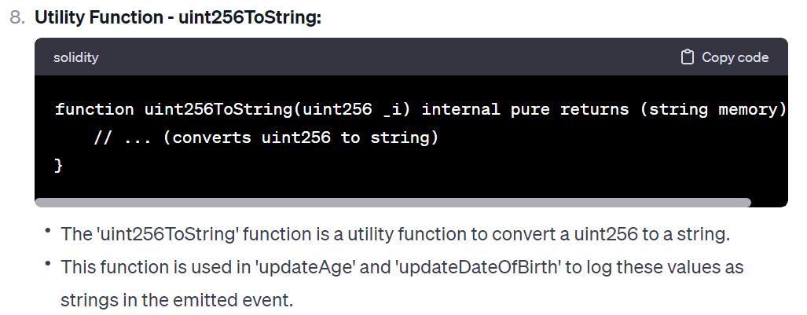

Slide 14
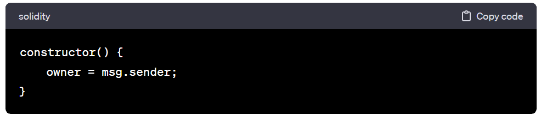
In Solidity, a constructor is a special function that is executed only once when the contract is deployed. It is used to initialize the state variables and perform any setup that needs to be done at the beginning of the contract's existence.

Slide 15
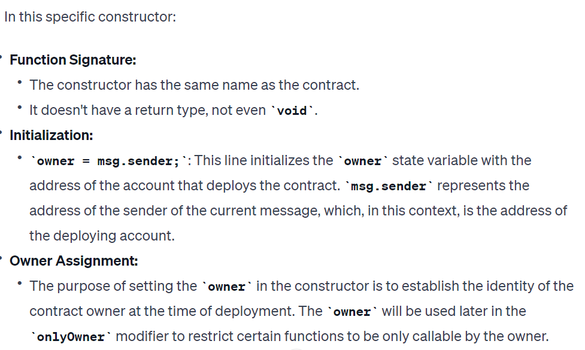

Slide 16
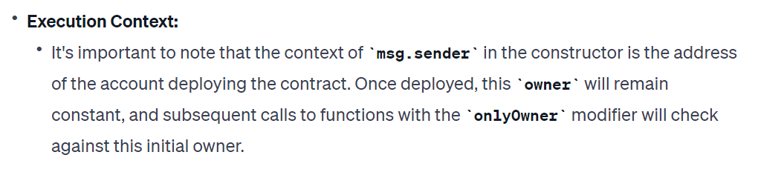

Slide 17
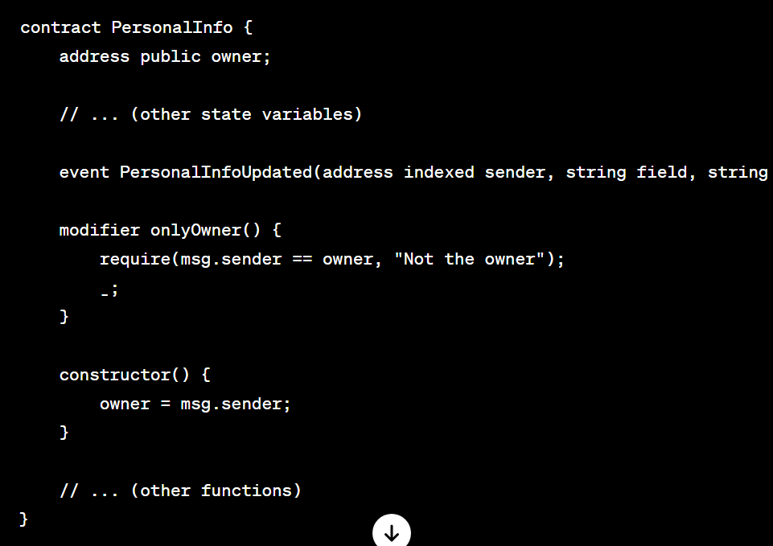
Here's how the constructor fits into the overall contra

Slide 18
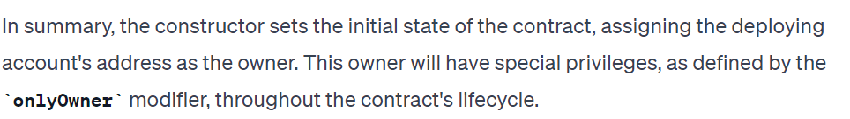
In summary, the constructor sets the initial state of the contract, assigning the deploying account's address as the owner. This owner will have special privileges, as defined by the onlyOwner modifier, throughout the contract's lifecycle.

